Slide 1

RNN on MNIST

Slide 2
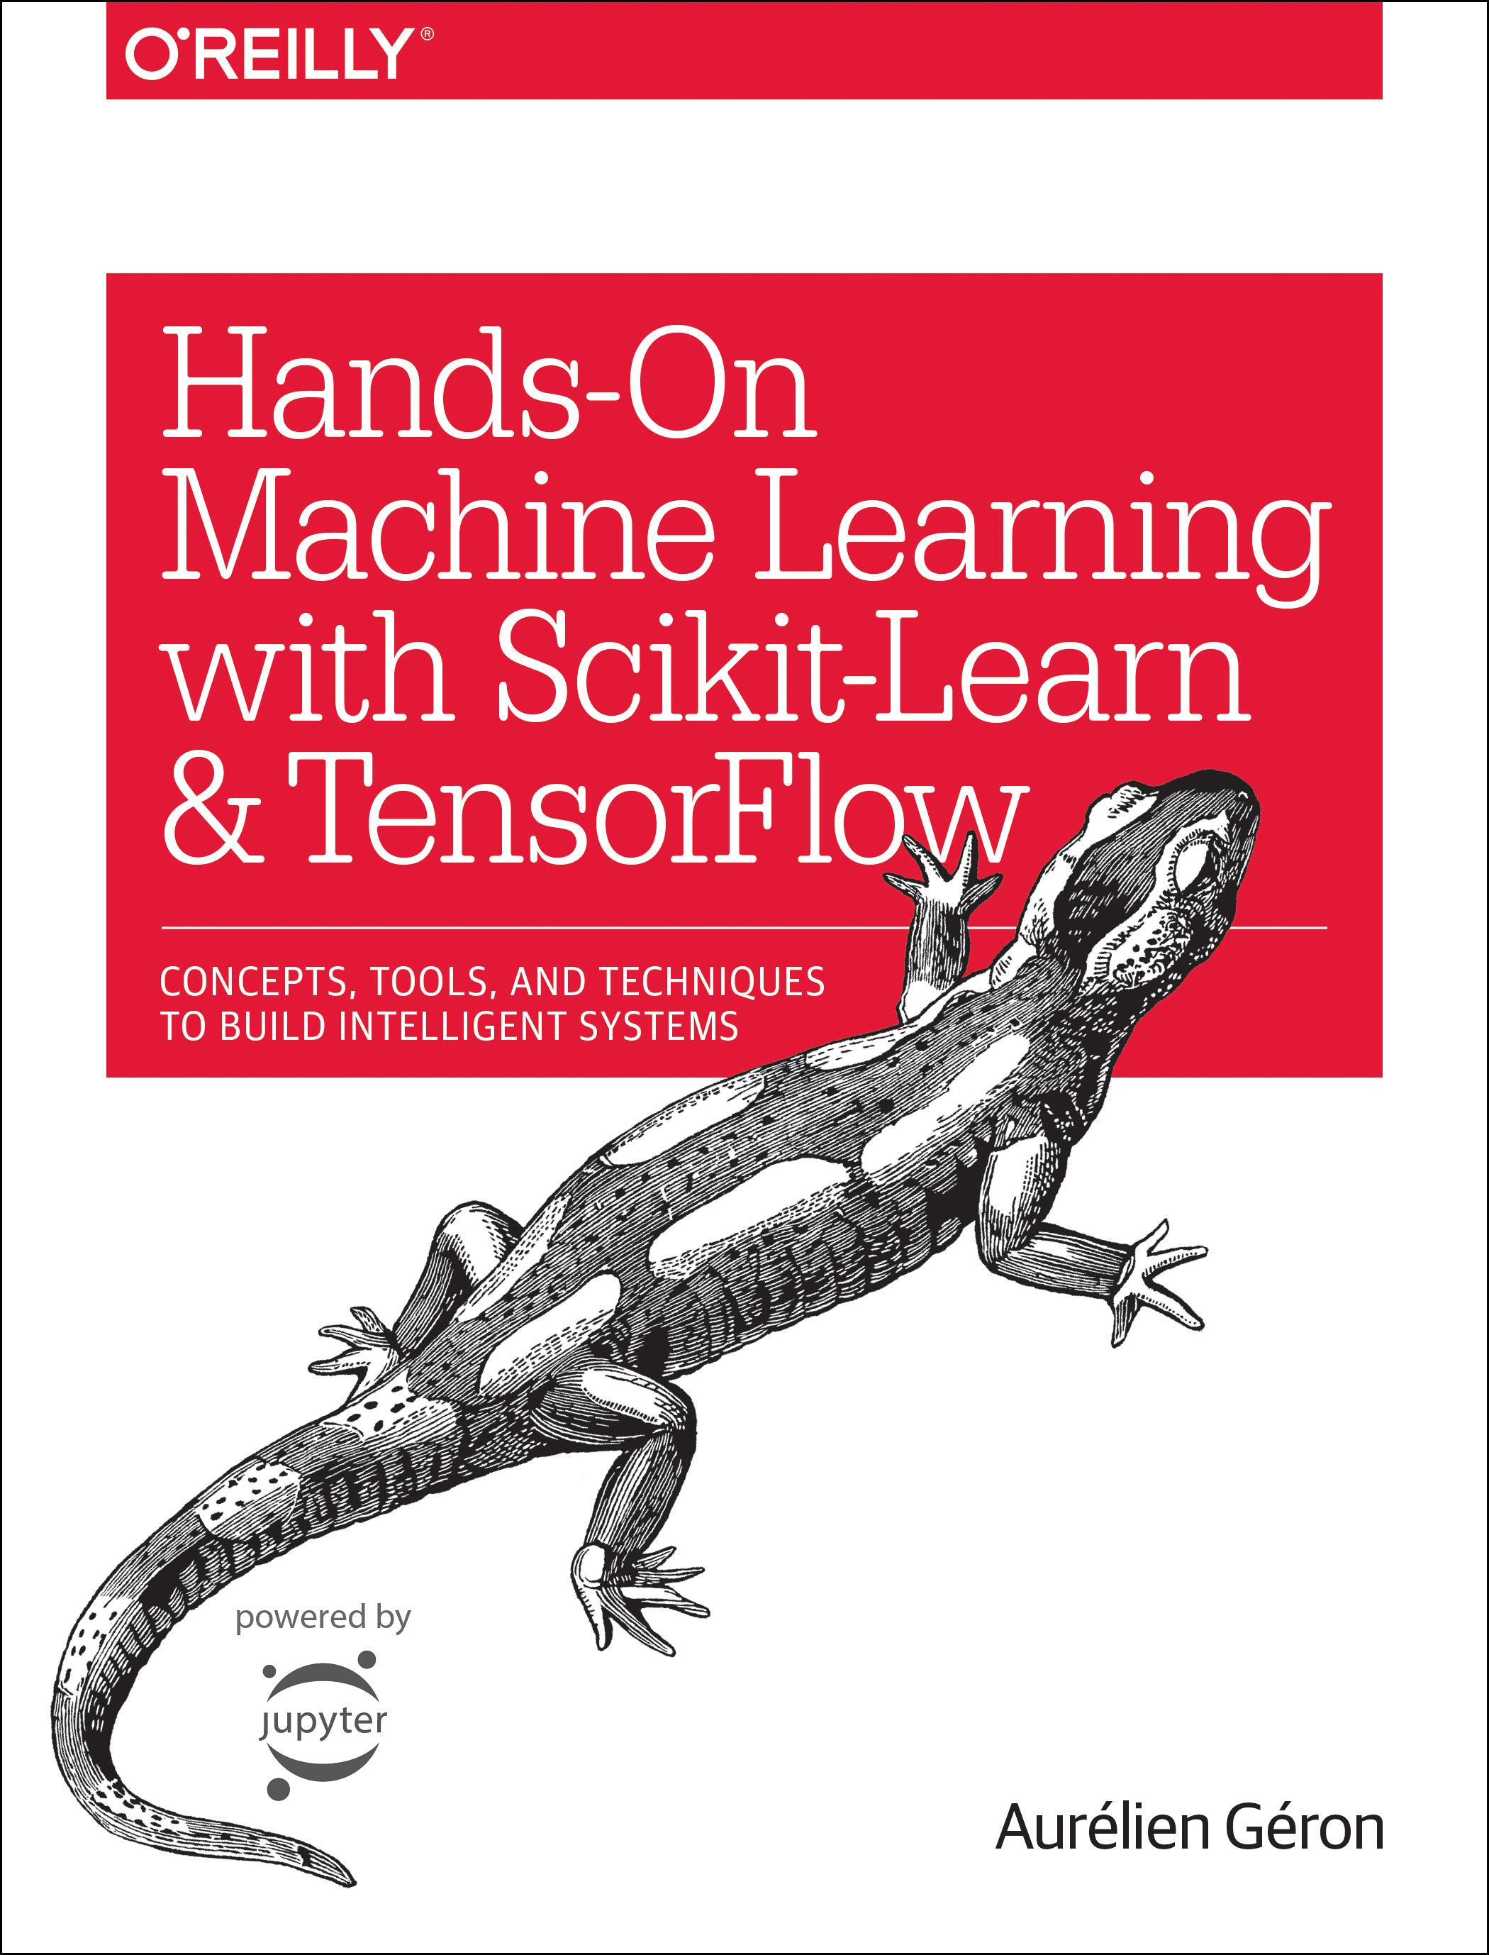
Reference
Chapter 14 (O'Reilly) of Hands-On ML
Youtube on MNIST
Youtube on CNN on MNIST
Youtube
Code

Slide 3
Data

Slide 4
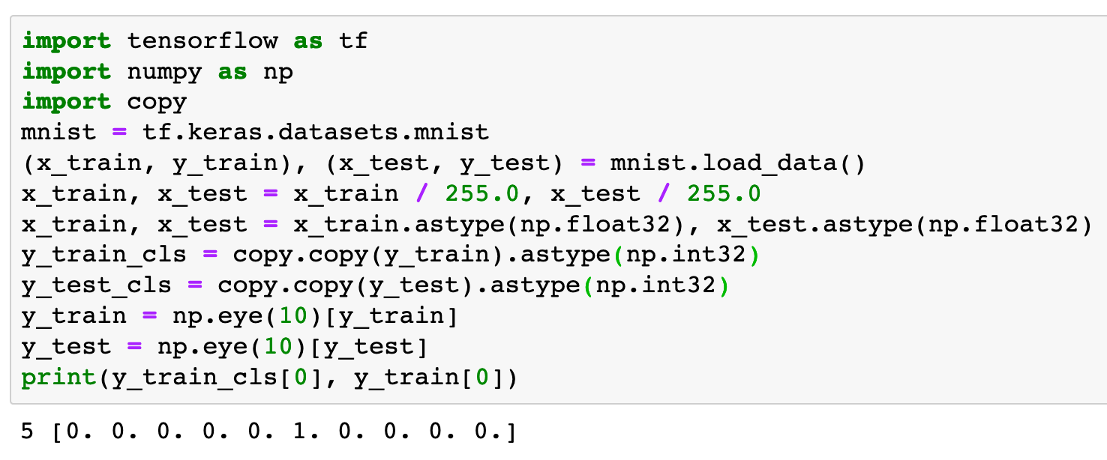

Slide 5
Warm Up

Slide 6
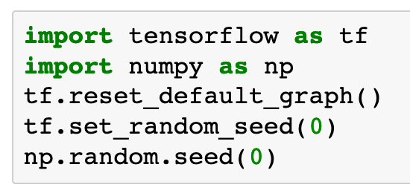

Slide 7
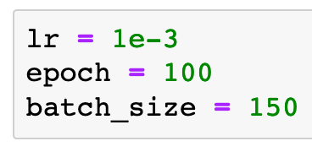

Slide 8
Graph

Slide 9
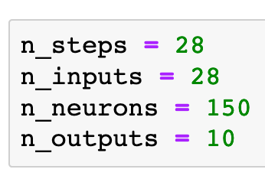

Slide 10
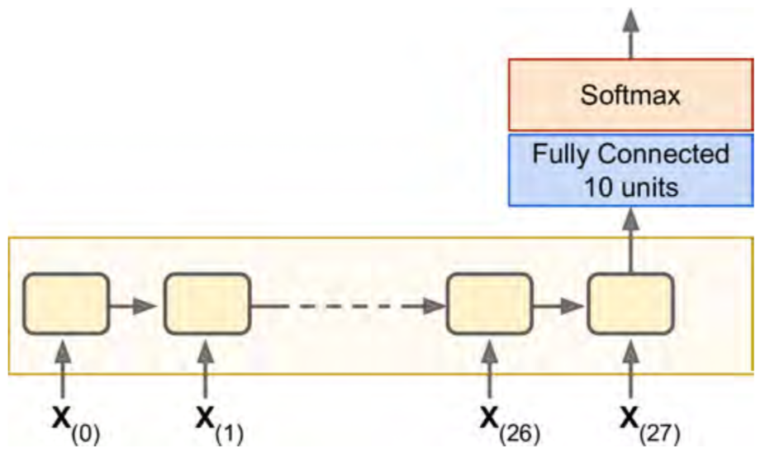
Chapter 14 (O'Reilly) of Hands-On ML

Slide 11


Chapter 14 (O'Reilly) of Hands-On ML

Slide 12

Chapter 14 (O'Reilly) of Hands-On ML

Slide 13
Chapter 14 (O'Reilly) of Hands-On ML

Slide 14
Chapter 14 (O'Reilly) of Hands-On ML

Slide 15

Chapter 14 (O'Reilly) of Hands-On ML

Slide 16
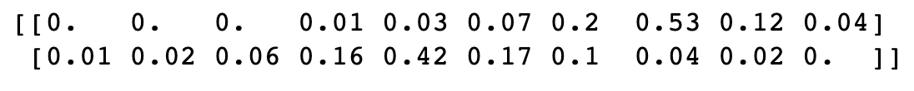
Chapter 14 (O'Reilly) of Hands-On ML

Slide 17
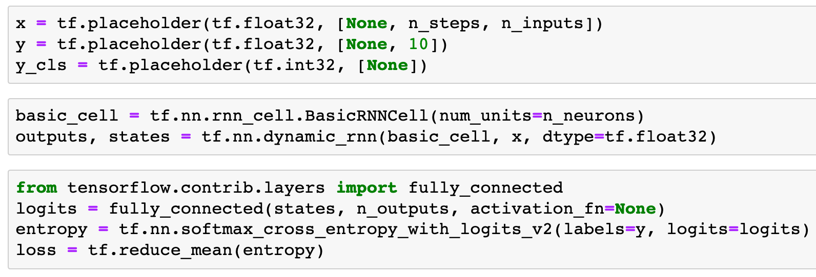

Chapter 14 (O'Reilly) of Hands-On ML

Slide 18
Chapter 14 (O'Reilly) of Hands-On ML
x

Slide 19
Chapter 14 (O'Reilly) of Hands-On ML
(?,28,28)
x

Slide 20
Chapter 14 (O'Reilly) of Hands-On ML
(?,28,28)
x

Slide 21
Chapter 14 (O'Reilly) of Hands-On ML
states
(?,28,28)
x

Slide 22
Chapter 14 (O'Reilly) of Hands-On ML
states
(?,150)
(?,28,28)
x

Slide 23
Chapter 14 (O'Reilly) of Hands-On ML
states
(?,150)
(?,28,28)
x

Slide 24
Chapter 14 (O'Reilly) of Hands-On ML
logits
states
(?,150)
x

Slide 25
Chapter 14 (O'Reilly) of Hands-On ML
(?,10)
logits
states
(?,150)
x

Slide 26
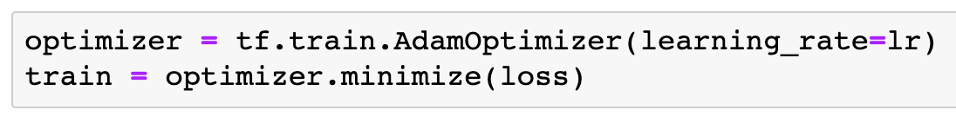

Slide 27
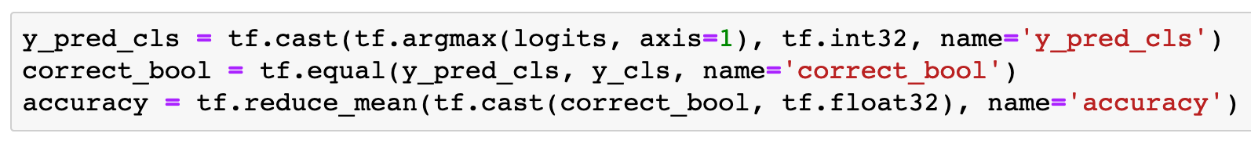

Slide 28
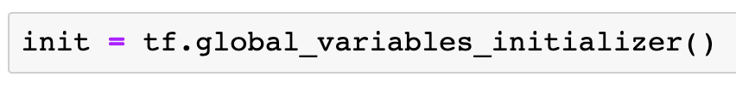

Slide 29
Session

Slide 30
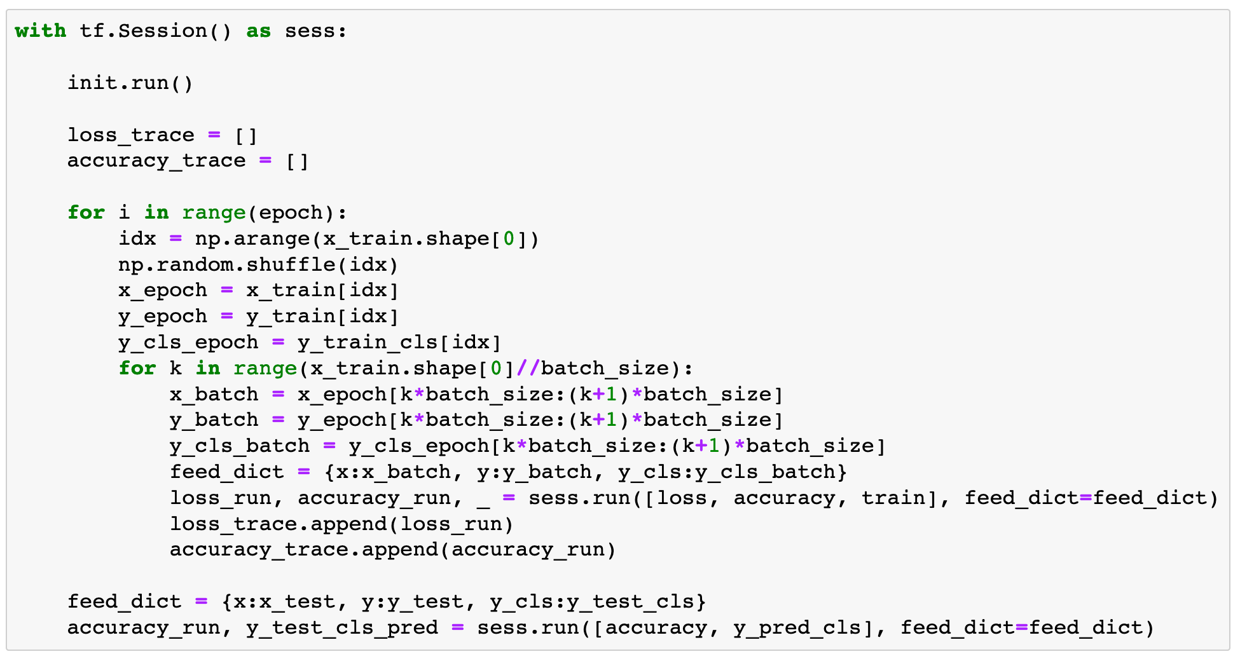

Slide 31
Report Result

Slide 32
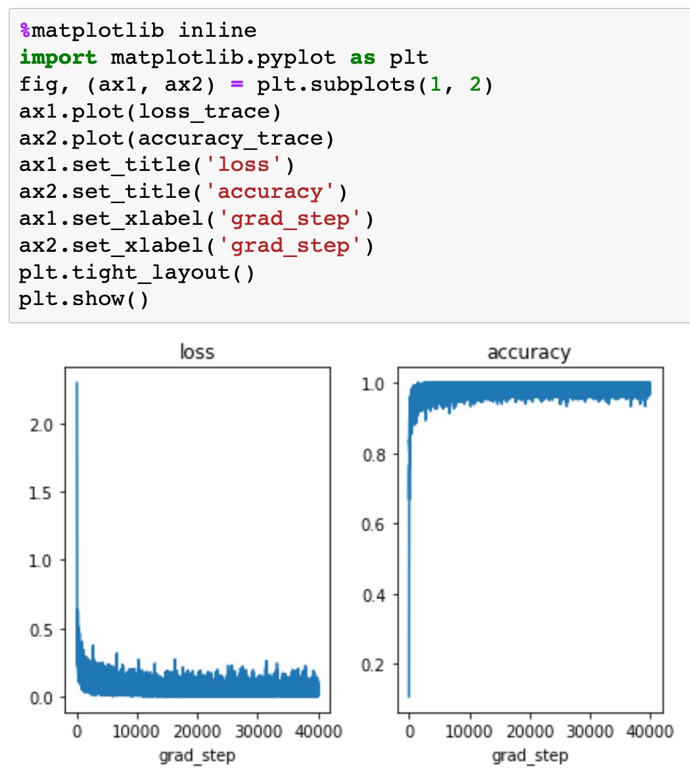

Slide 33
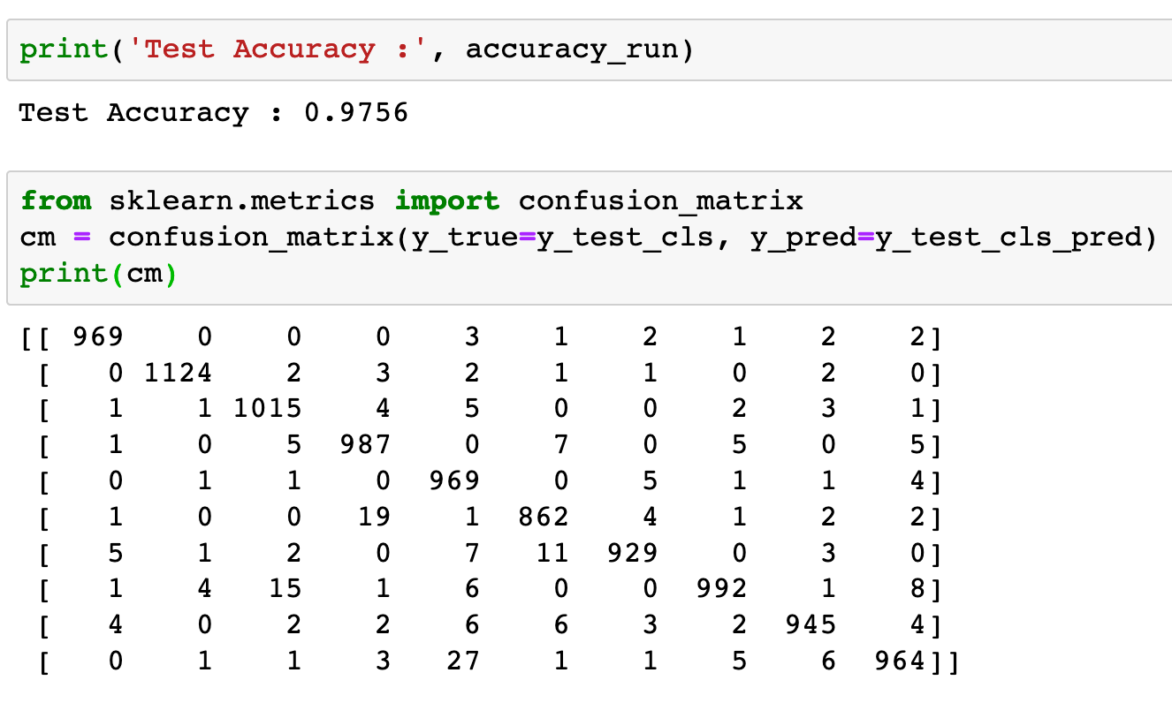


Slide 35
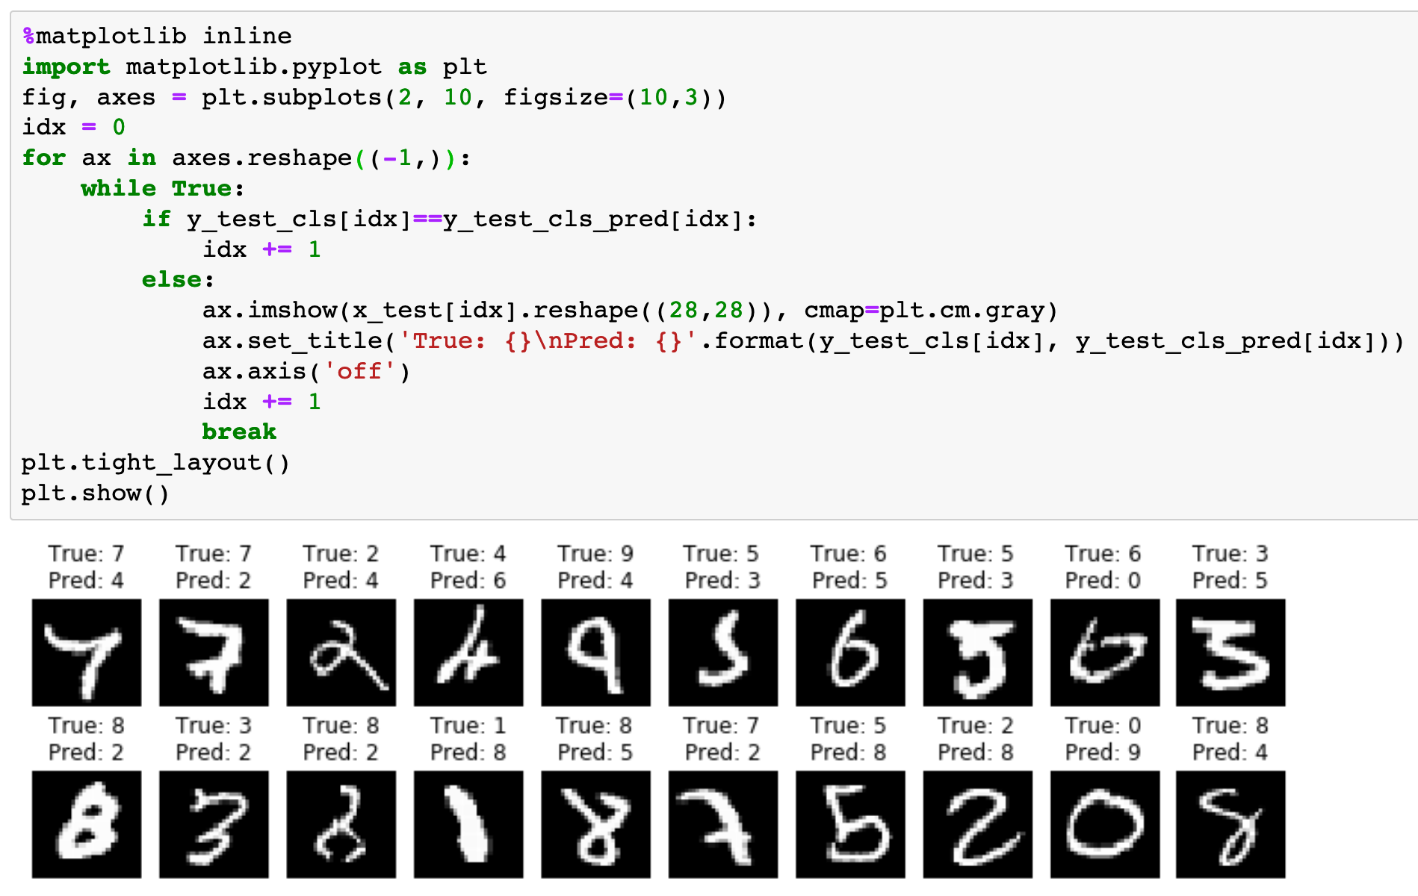

Slide 36
Now
Let’s Play with Code

